Slide 1
Kisan Buddy Mahindra FarmEq
PIP2001 Capstone Project
VIVA-VOCE
Batch Number: CSE-205
Roll Number | Student Name
20211CSE0884 | KAKARLA MANOJ KUMAR
20211CSE0164 | ALURU SIVA SAHITHI
20221LCS0005 | SHREYANK S
Under the Supervision of,
DR .Abdul Khadar A Associate Professor
School of Computer Science and Engineering
Presidency University
Name of the Program: B.TECH COMPUTER SCIENCE AND ENGINEERING [CSE]
Name of the HoD: DR.ASIF MOHAMMED H.B
Name of the Program Project Coordinator: MR.AMARNATH J.L
Name of the School Project Coordinators: Dr. Sampath A K / Dr. Abdul Khadar A / Mr. Md Ziaur Rahman

Slide 2
Introduction
Agriculture remains the backbone of many economies, especially in rural areas where farmers rely on traditional methods to sell their produce. However, these conventional systems are often plagued by inefficiencies, including limited market access, communication barriers between farmers and mandi shops, and delayed payments. The growing need to modernize and streamline agricultural transactions has prompted the development of digital solutions that empower farmers with direct access to markets and better control over their produce sales. This Android application seeks to bridge the gap between farmers and mandi shops by offering a comprehensive platform that facilitates seamless communication and transactions. The app is designed with three core modules—Admin, Mandi Shops, and Farmer each tailored to meet the specific needs of the respective users. Farmers can easily register, log in, submit requests for selling produce, view their transaction history, and make payments. Mandi shops can log in, view and update requests, manage costs, and track the status of transactions, while the Admin module ensures efficient oversight of mandi shops and farmers. By integrating locationbased services, the application helps farmers connect with nearby mandi shops, improving market accessibility. The platform also ensures transparency and security in transactions, enabling farmers to receive timely payments and track their requests. With its user-friendly design and streamlined process, the app aims to revolutionize agricultural transactions by providing a digital solution that benefits both farmers and mandi shop owners, enhancing the efficiency of the overall system.

Slide 3
Literature Review
The increasing digitization of agriculture has provided significant opportunities to address challenges faced by farmers, particularly in market accessibility. Several studies highlight the role of digital platforms and mobile applications in revolutionizing the agricultural sector.
Agrawal and Pandey (2021) examined the impact of digital solutions on enhancing market access for Indian farmers. They emphasized that mobile apps and online platforms empower smallholder farmers by offering real-time market information, connecting them with buyers, and improving price transparency.
Reddy and Mishra (2020) identified systemic challenges within the Indian agricultural supply chain, such as inadequate infrastructure and the exploitation by intermediaries. Their work suggested that technology-driven solutions, combined with policy reforms, could alleviate these issues.

Slide 4
Literature Review
Kumar and Joshi (2019) highlighted the transformative role of e-marketplaces and precision agriculture tools in reducing transaction costs and eliminating middlemen, ensuring better pricing for farmers.
Singh and Sharma (2020) focused on mobile applications' role in increasing market efficiency for small farmers. Their case studies demonstrated how mobile platforms streamline processes, reduce information asymmetry, and provide direct access to buyers.
Mukherjee and Roy (2018) reviewed successful ICT interventions like the eNAM platform, noting their contributions to providing market information and fostering transparency in agricultural transactions.

Slide 5
Existing method Drawback
Limited Transparency
Farmers cannot track transactions or verify prices due to the absence of a structured system, leading to exploitation by intermediaries.
Time-Consuming and Inefficient
Farmers must physically visit mandi shops to negotiate prices and sell their produce, which is both time-intensive and resource-draining.
Delayed Payments
The manual process often results in delays in payment to farmers, negatively affecting their financial stability and cash flow.
Inefficient Market Access
Farmers struggle to find the best mandi shops for their produce due to inadequate communication and lack of real-time updates on market conditions

Slide 6
Existing method Drawback
Dependence on Intermediaries
The current system heavily relies on middlemen, reducing farmers’ profit margins and creating bottlenecks in the supply chain.
Lack of Technology Utilization
The existing methods do not leverage modern technologies like GPS, digital payment systems, or real-time data sharing, resulting in outdated and inefficient processes.
Inadequate Record-Keeping
Manual systems do not provide reliable transaction history or data, making it difficult for farmers to track their earnings and manage future planning

Slide 7
Research Gaps Identified
Limited Digital Infrastructure for Farmers: Many existing solutions focus on urban or semi-urban areas and often neglect rural farmers who may lack access to stable internet or smartphones.
Fragmentation in Mandi Shop Integration: Current platforms do not fully integrate real-time data from multiple mandi shops, leading to incomplete or outdated pricing and stock information for farmers.
Transparency Issues: While some systems aim to reduce middlemen exploitation, few provide end-to-end transparency, especially regarding transaction tracking and payment processing.

Slide 8
Research Gaps Identified
Underutilization of Advanced Technologies: Existing solutions do not incorporate advanced analytics, AI for price recommendations, or blockchain for secure and transparent transactions.
Lack of Multilingual and User-Friendly Interfaces: Many platforms fail to address language diversity and ease of use for farmers who may not be literate in the application's default language.
Challenges in Real-Time Interaction: Most systems do not include features for direct, real-time communication between farmers and mandi shops, such as chat or video support.

Slide 9
Research Gaps Identified
Limited Focus on Predictive Insights: Few existing systems leverage predictive analytics for helping farmers decide the best time to sell or guiding them on crop selection based on market trends.
Inadequate Support for Diverse Payment Systems: Current applications often provide limited options for digital payments, reducing their accessibility and usability for all farmers.

Slide 10
Proposed methodology
The methodology for developing the Android application involves a systematic approach that incorporates design, development, integration, and testing phases to ensure the efficient functioning of the three key modules: Admin, Mandi Shops, and Farmers. The methodology can be broken down as follows:
Requirements Analysis :
Objective: Understand the core functionalities required by each user group (Admin, Mandi Shops, and Farmers) and gather requirements for the integration of location services.
Approach: Conduct stakeholder interviews with administrators, mandi shop owners, and farmers to identify needs and challenges. Document user stories for each module. Determine key interactions such as login, registration, produce requests, and location based connections.

Slide 11
Proposed methodology
System Design and Architecture
Objective: Design a scalable and efficient architecture to support the three modules while ensuring seamless integration between them and location services.
Approach:
Modular Design: Define clear boundaries and interfaces for the Admin, Mandi Shops, and Farmers modules.
Database Schema: Create a relational database schema to handle user data, transaction history, and produce details.
Location Services Integration: Leverage Android’s location APIs to ensure that farmers are matched with the nearest mandi shops.

Slide 12
Objectives
1. Input Design is the process of converting a user-oriented description of the input into a computer-based system. This design is important to avoid errors in the data input process and show the correct direction to the management for getting correct information from the computerized system.
2. It is achieved by creating user-friendly screens for the data entry to handle large volume of data. The goal of designing input is to make data entry easier and to be free from errors. The data entry screen is designed in such a way that all the data manipulates can be performed. It also provides record viewing facilities.
3. When the data is entered it will check for its validity. Data can be entered with the help of screens. Appropriate messages are provided as when needed so that the user will not be in maize of instant. Thus the objective of input design is to create an input layout that is easy to follow

Slide 13
Methods/modules
Modules
Admin Module
Mandi Shops Module
Farmer Module
Methods
Development Approach
Data Management
User Interface Design
Location-Based Services
Testing

Slide 14
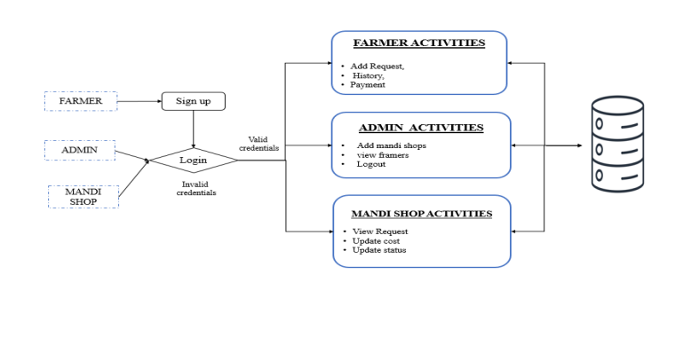
Architecture

Slide 15
Hardware/software components
Hardware Requirements
• Processor - I3/Intel Processor
• RAM - 8 GB
• Hard Disk - 1TB
Software Requirements
• Operating System - Windows 10
• JDK - java • Plugin –Kotlin
• SDK - Android
• IDE -Android studio
• Database` - sql

Slide 16
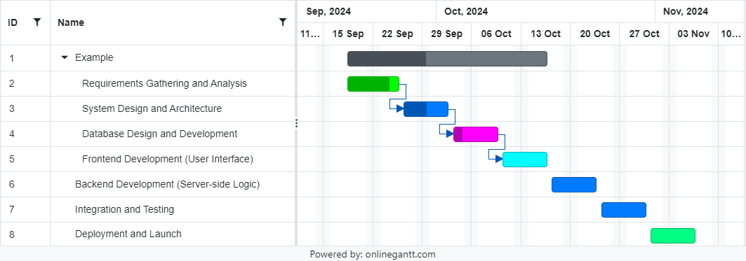
Timeline of Project(GANTT CHART )
A Gantt chart is a project management tool used to visually represent a project schedule. It displays tasks, activities, or events along a timeline, helping teams track progress, allocate resources, and manage deadlines effectively.

Slide 17
Expected Outcomes
Improved Market Access for Farmers Farmers can connect directly with nearby mandi shops, eliminating the inefficiencies of traditional systems.
Enhanced Transparency in Transactions Real-time updates on produce prices, request statuses, and payment tracking ensure transparency between farmers and mandi shops.
Streamlined Agricultural Processes Digital platforms simplify the workflow for farmers and mandi shops, including request submission, price updates, and transaction management.
Efficient Payment Processing Integration of a secure payment gateway enables timely and reliable financial transactions.
Better Decision-Making Farmers gain access to real-time data and location-based services, helping them make informed decisions about selling their produce.

Slide 18
Expected Outcomes
6.Administrative Oversight The Admin module allows for effective management of users and monitoring of system operations.
7.Increased Farmer Empowerment By reducing dependency on intermediaries, the application enhances farmers' ability to secure fair prices and manage their produce efficiently.
8.Scalable and User-Friendly System The app's intuitive interface and modular design ensure ease of use and adaptability for various users.

Slide 19
Conclusion
The Android application successfully bridges the gap between farmers and mandi shops, providing a streamlined and user-friendly platform for interactions. By incorporating features such as location services, real-time price updates, and transaction tracking, the app enhances communication and transparency in the agricultural value chain. Farmers can now easily connect with nearby mandi shops, manage their transactions, and make informed decisions, ultimately leading to better market efficiency and improved livelihoods for farmers. The application ensures that the process of selling agricultural products becomes more accessible and less cumbersome for all stakeholders involved.

Slide 20
Conclusion
The Android application successfully bridges the gap between farmers and mandi shops, providing a streamlined and user-friendly platform for interactions. By incorporating features such as location services, real-time price updates, and transaction tracking, the app enhances communication and transparency in the agricultural value chain. Farmers can now easily connect with nearby mandi shops, manage their transactions, and make informed decisions, ultimately leading to better market efficiency and improved livelihoods for farmers. The application ensures that the process of selling agricultural products becomes more accessible and less cumbersome for all stakeholders involved.

Slide 21
References
• Reddy, A. A., & Mishra, D. (2020). "Challenges and Opportunities in the Indian Agricultural Market: A Farmer's Perspective." Agricultural Economics Review, 25(3), 120-132.
• Kumar, P., & Joshi, P. K. (2019). "Technological Innovations for Market Linkages in Indian Agriculture." Agriculture and Food Security Journal, 8(1), 45-53.
• Singh, R., & Sharma, K. (2020). "Role of Mobile Applications in Enhancing Market Efficiency for Small Farmers." International Journal of Agricultural Extension, 17(2), 95 108.
• Mukherjee, S., & Roy, A. (2018). "Improving Agricultural Market Access through ICT: A Review of Success Stories in India." Journal of Rural Development Studies, 14(2), 234 247.
• Jain, S., & Patel, A. (2021). "Mandi Connect: A Mobile Application to Bridge the Gap Between Farmers and Markets." International Journal of Digital Transformation, 5(4), 102-112.
• Gupta, V., & Singh, H. (2022). "Digitization of Agricultural Market Systems: A Case Study of Mandi Networks in India." Journal of Applied Agricultural Research, 9(1), 77 89.

Slide 22
Project work mapping with SDG
The proposed Android application for connecting farmers and mandi shops directly aligns with the following Sustainable Development Goals (SDGs):
SDG 1: No Poverty
By providing farmers direct access to mandi shops and reducing dependency on intermediaries, the application helps improve farmers' income and livelihoods.
SDG 2: Zero Hunger
Efficient agricultural transactions ensure timely sales of produce, reduce waste, and enhance food security by strengthening market systems.
SDG 8: Decent Work and Economic Growth
The app supports farmers and mandi shops in increasing efficiency and profitability, fostering economic growth in rural areas through fair trade practices
SDG 9: Industry, Innovation, and Infrastructure
The integration of digital technologies like mobile applications, GPS, and secure payment gateways enhances agricultural infrastructure and drives innovation in the sector.

Slide 23
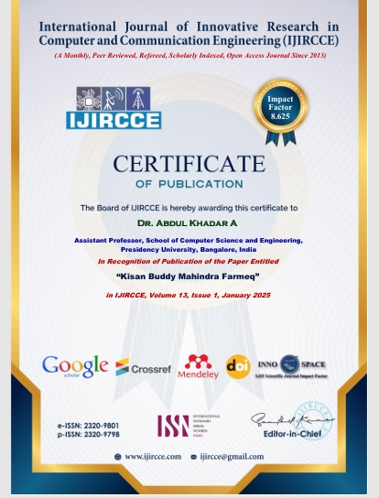
Publication

Slide 24
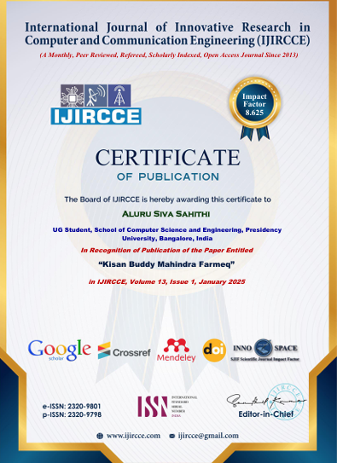
Publication

Slide 25
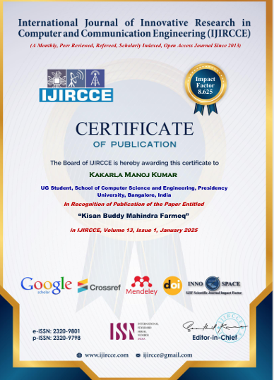
Publication

Slide 26
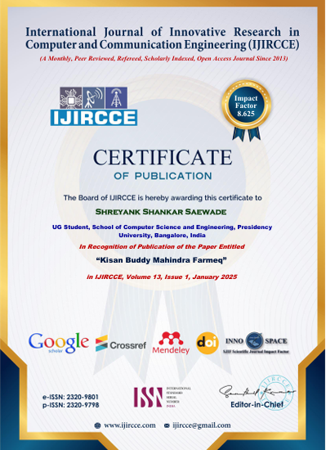
Publication

Slide 27
Github Link
https://github.com/Manoj28012003/kissan-Buddy

Slide 28


